Slide 1





Certificate
Booking
system
Visit Our Website
Quickcivic

Slide 2


Team Members
Ram Chetlaoalli (VU21CSEN0100274)
vamshi Gunda
(VU21CSEN0100341)
Moturi Chaitra
(VU21CSEN0100437)
Dhanya Sree
(VU21CSEN0100348)
Hrhithesh Gudaru
(VU21CSEN0100274)

Slide 3


Vision And Mission
Our Vision
To empower citizens with seamless and efficient access to essential government services and documents, fostering a transparent and user-centric digital governance experience.
Our Mission
To make applying for and receiving government services and documents quick, easy, and hassle-free for everyone.

Slide 4
complexity understanding
Error Handling
Input Validation
File Upload Validation
Payment Error Handling
Security Concerns
Data Protection
OTP Security
File Upload Security
Dynamic Behavior
Conditional Logic
User Input:
Dynamic Generation of Elements
Interconnected Systems
Frontend and Backend Integration:
Multiple Document Types
External Dependencies
OTP Generation and Delivery
Payment Processing
Government Databases

Slide 5
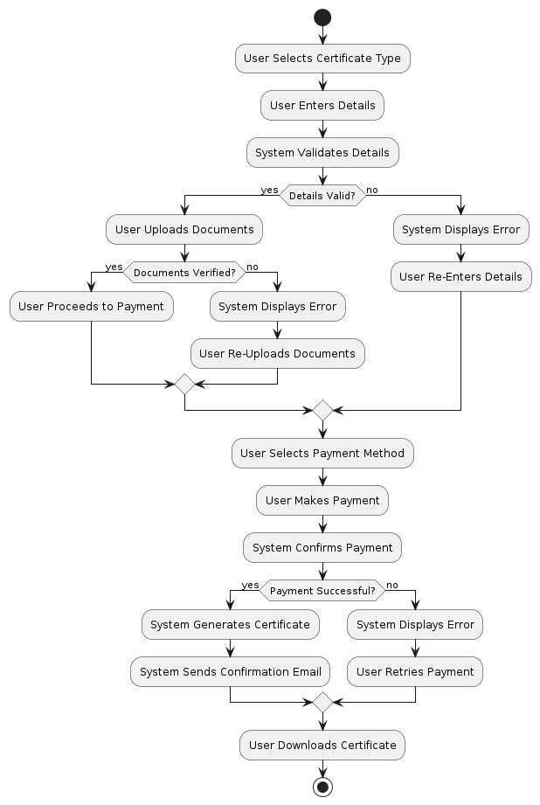
complexity understanding

Slide 6
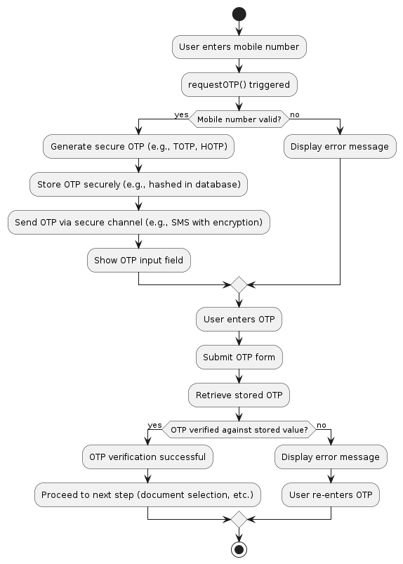
Security Implementation
Strong OTP Generation
Secure OTP Storage
Secure OTP Transmission
Robust OTP Verification

Slide 7
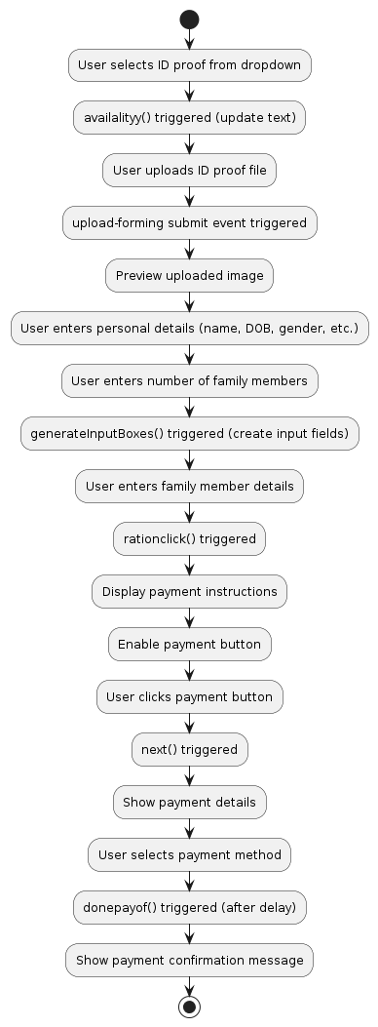
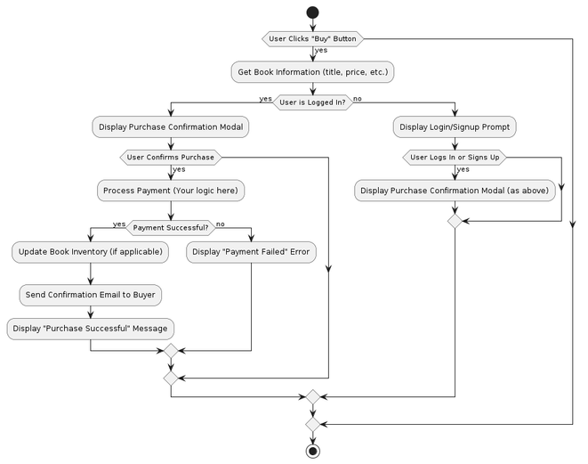
Unit Testing Skill
Ration Card Functionality : The ration card serves as a vital tool in India's public distribution system. It ensures food security by enabling eligible households to purchase essential commodities at subsidized rates from fair price shops. The ration card acts as an official identification document and proof of address.
Digitization
Aadhaar linking
Direct Benefit Transfer
One Nation One Ration Card
Real-time monitoring

Slide 8
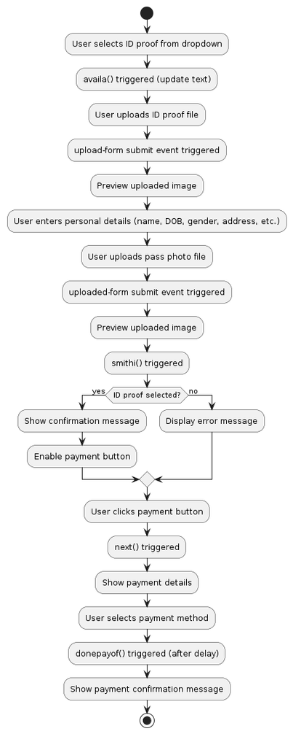
Unit Testing Skill
Adhar Card Functionality : Aadhaar, as India's biometric-based unique identification system, plays a crucial role in various government initiatives and welfare programs. In the context of the discussed project, Aadhaar's functionality could be leveraged in the following ways
Enhanced Authentication
Efficient Beneficiary Identification
Streamlined DBT
Data-Driven Decision Making
Increased Transparency and Accountability:

Slide 9
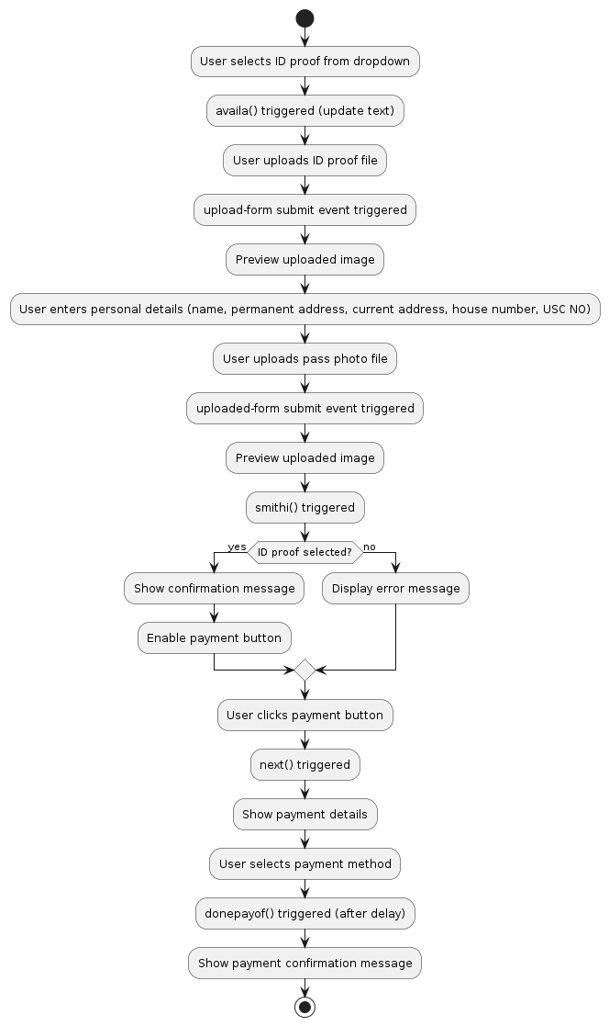
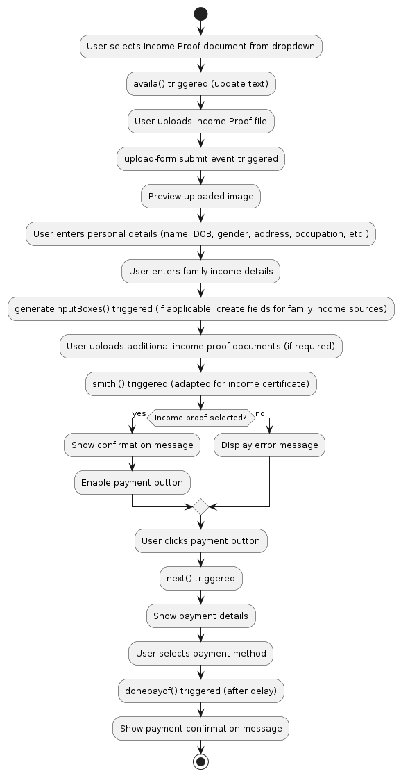
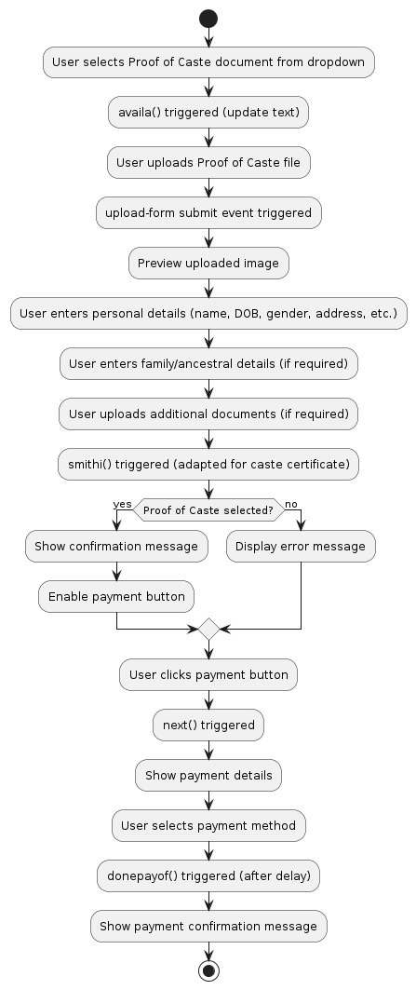
Voter ID
Death certifiate
Caste certifiate
income

Slide 10
Validation and Error Handling
Preventing crashes: Your app should gracefully handle unexpected errors, like network issues or invalid user input, so it doesn't break.
Guiding users: Clear error messages help users fix mistakes and complete tasks smoothly.
Protecting your data: Validation ensures that only correct and safe data is stored in your system.
sell funtionality

Slide 11
Validation and Error Handling
Validate: Ensure data accuracy and security through client-side and server-side checks.
Handle Errors Gracefully: Catch exceptions, log errors, and display user-friendly messages.
Prioritize Security: Don't expose sensitive information in error messages.
Enhance User Experience: Guide users to correct input and provide helpful feedback.
sell funtionality

Slide 12
Thank You
For Your Attention
Visit Our Website
applycertificate

